Slide 1
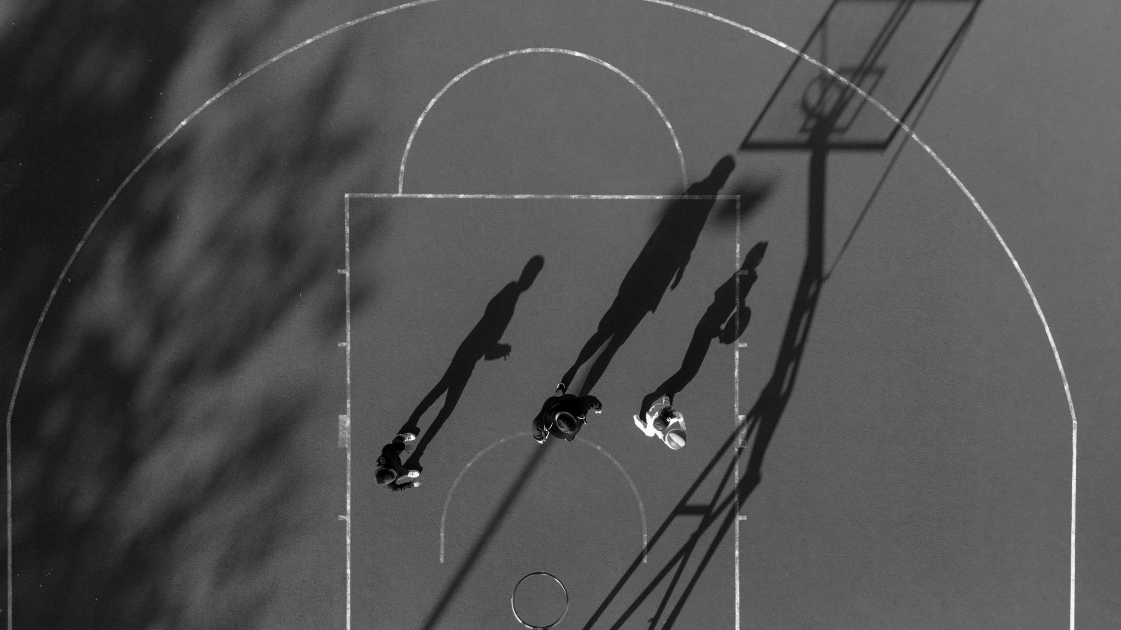
NYC Mayoral Election AI Chatbot - AWS
8/12/2025
Jiahong Liu
Minimal Viable Product

Slide 2
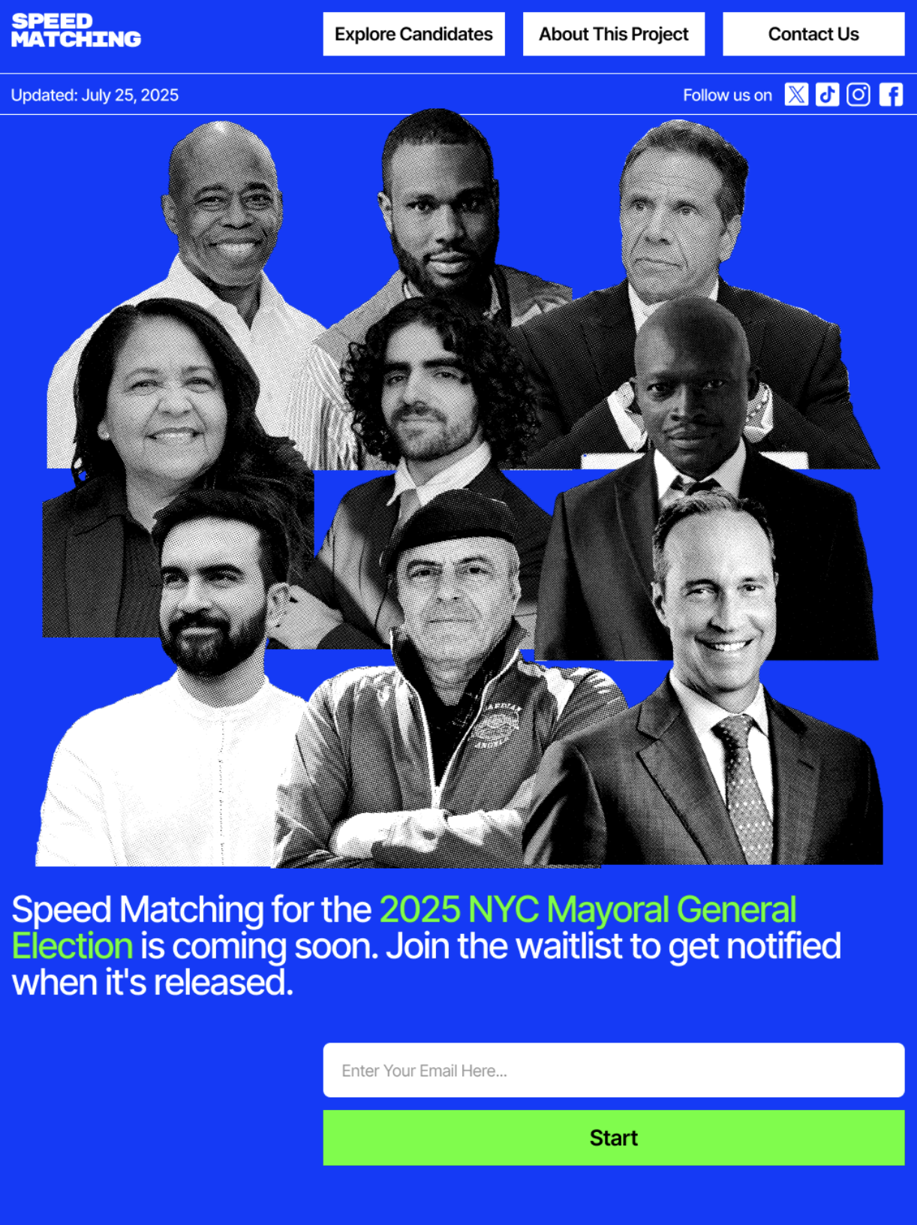
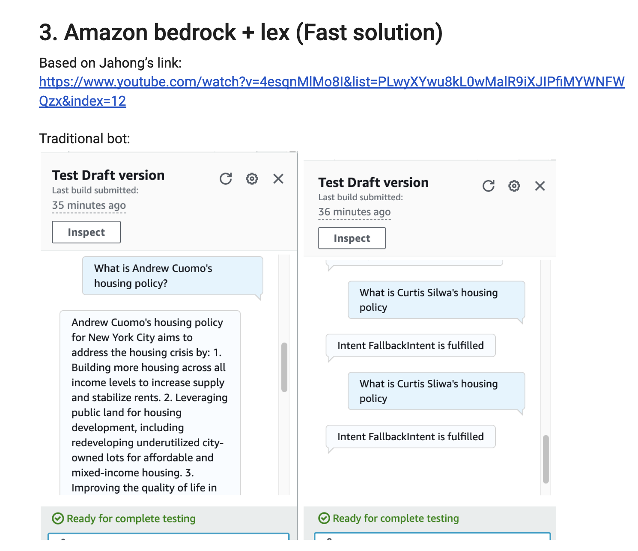
Intro
NYC Mayoral Election AI chatbot that will be able to answer voters’ questions about NYC Mayoral Election Candidates
It is part of a quiz app that matches NYC voters' policy preferences with 2025 mayoral candidates' positions to help them decide who to vote for
POC AWS
Jiahong Liu
NYC Mayoral Election AI Chatbot

Slide 3
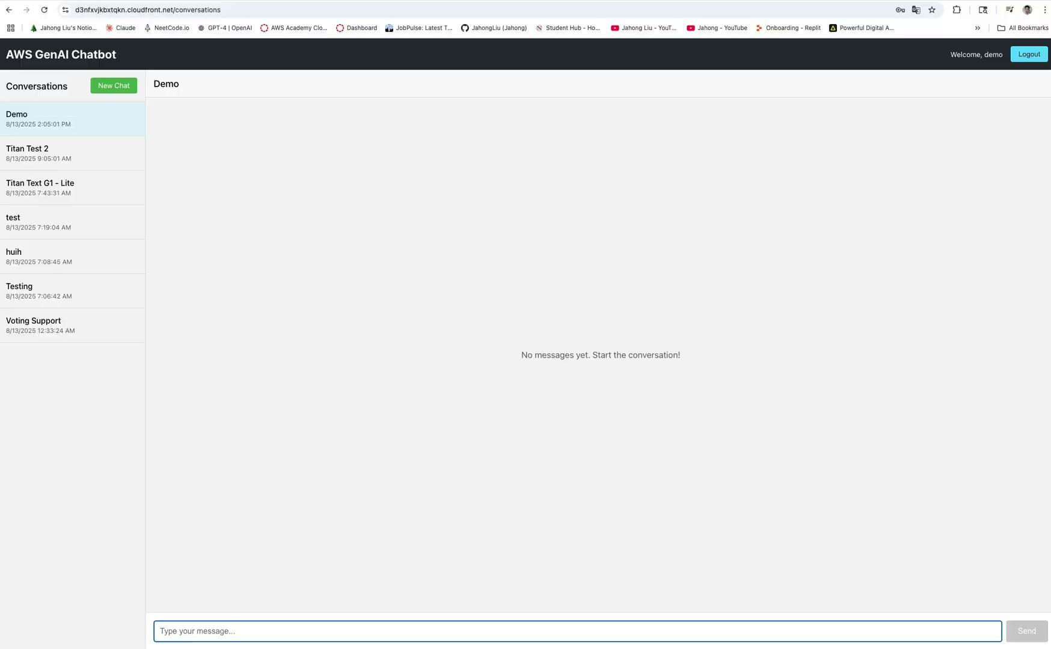
Demo
Business Name
NYC Mayoral Election AI Chatbot

Slide 4
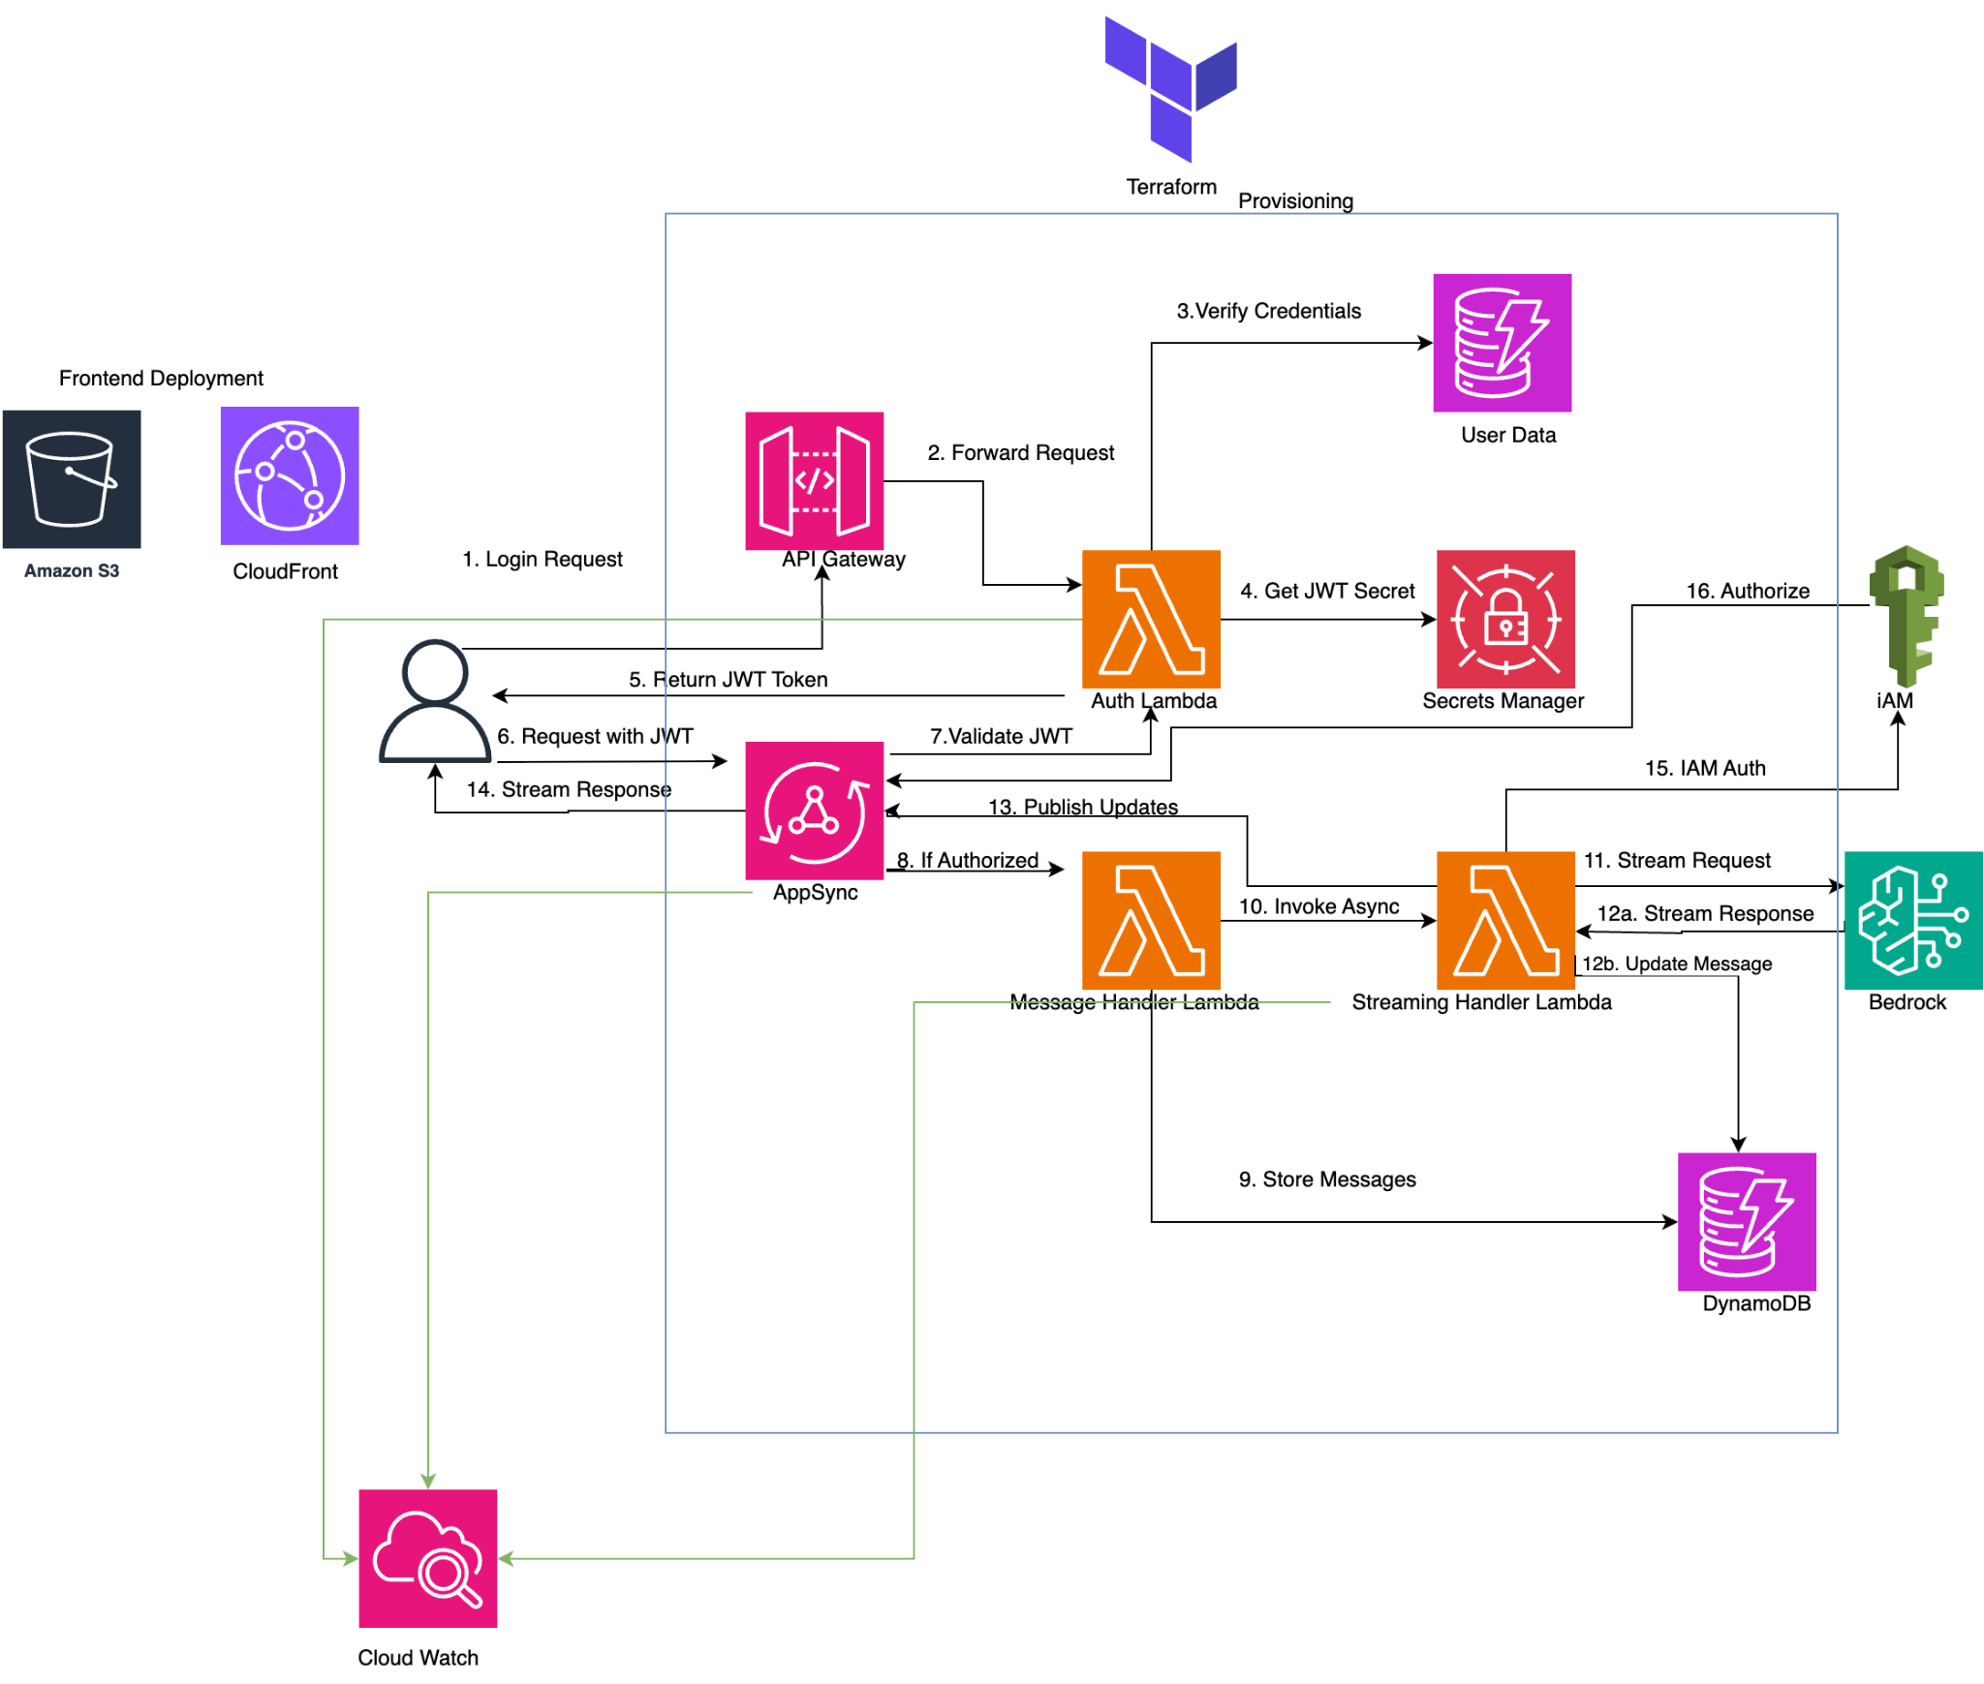
Design
Business Name
NYC Mayoral Election AI Chatbot

Slide 5
Used Terraform for provisioning.
AWS Services Used:
Bedrock: model inference
AppSync: GraphQL API + subscriptions
Lambda: auth-handler, message-handler, streaming handler
API Gateway: /login endpoint
DynamoDB: user table + chat data table
Secrets Manager: JWT secret for auth
S3 + CloudFront: hosting and serving the frontend
CloudWatch Logs: Logging for Lambdas (and AppSync)
IAM: roles/policies
Jiahong Liu
NYC Mayoral Election AI Chatbot

Slide 6
Challenges:
Random issues (e.g. walkaround mac apple issue, gatekeeper)
Setting up/ configuration (e.g. project_name affects s3 naming, unique)
AI still make mistakes, but it’s getting so good. How to use it properly.
Next:
Explore more AWS services
Apply RAG, Fine-tune to AI model
Integrate the UI
Jiahong Liu
NYC Mayoral Election AI Chatbot

Slide 7
Thank You
Jiahong Liu

